Slide 1
Phil Rumbley
Introduction
Assignment 1

Slide 2
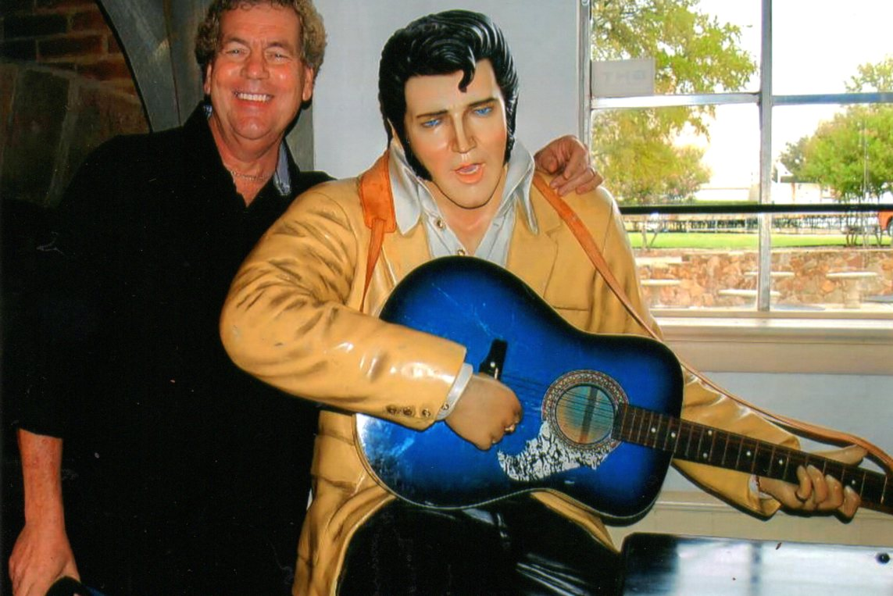
The Beginnings
I have the same birthday as Elvis (January 8), but not the same year.

Slide 3
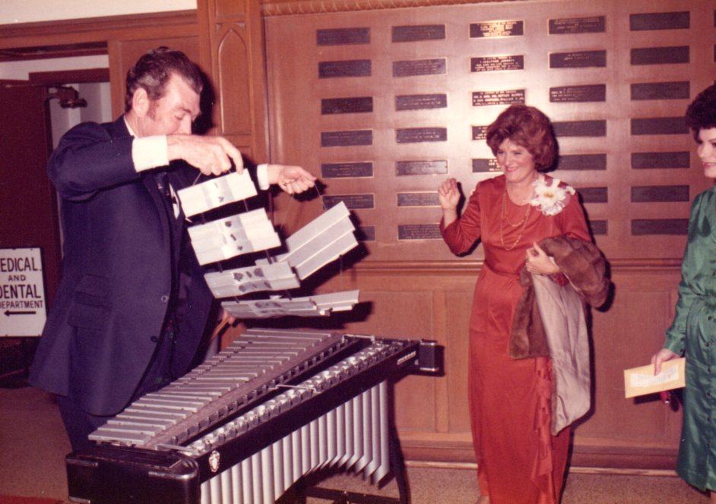
The beginnings
It was evident that I would be involved in music from day one. My father was with the Ft. Worth Symphony for 40 years, and my mother has her Ph.D in theater and communications.
Dad setting up his xylophone
While mom looks on at our
Wedding day, February 14, 1981

Slide 4
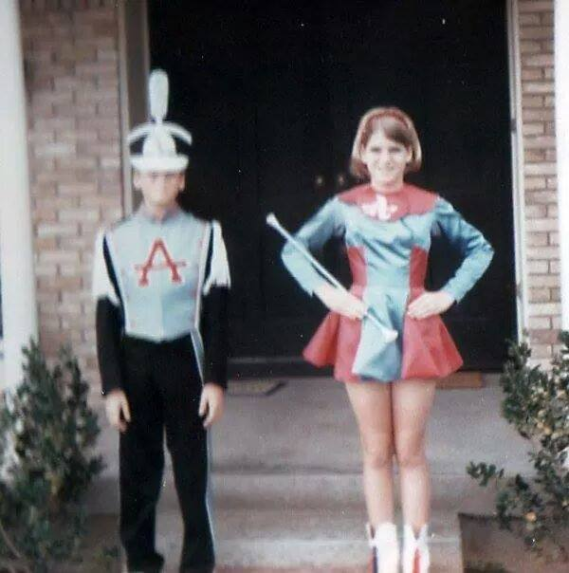
The beginnings
My first experience in playing an instrument was in fifth grade where I played trombone. I was fascinated with what you could do with the slide. My older sister Jill played the flute. I was the only sixth grader to make the Atwell Junior High marching band.
My junior high marching band uniform
Swallowed me whole. My sister wanted
To be a majorette.

Slide 5
The formative years
Even Santa Claus likes to play the
Trombone. My wife Karen bought
Me a P-bone for my birthday!

Slide 6
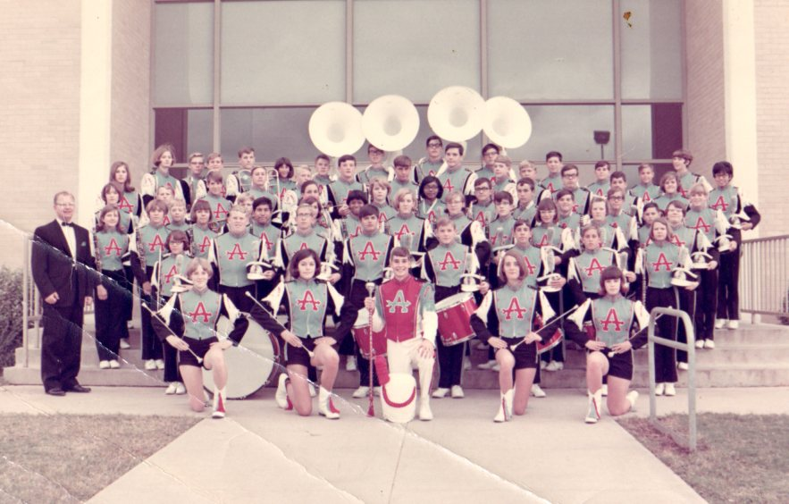
The beginnings
Mr. Williams our band director and the Atwell Junior High marching band

Slide 7
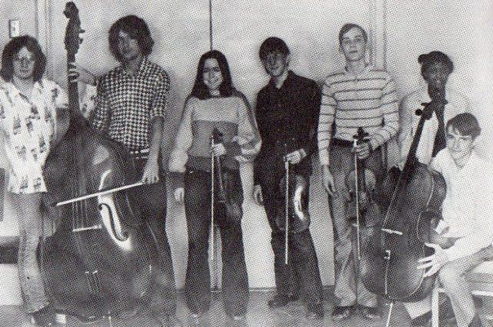
Formative years
In high school during the 70’s, rock music was a big influence and playing the trombone was no longer cool. I gravitated to the electric bass. I began playing string bass my senior year in high school with our very small orchestra.
My partner in crime Hal McCowan
Holding the string bass while I work on
My bowing technique.

Slide 8
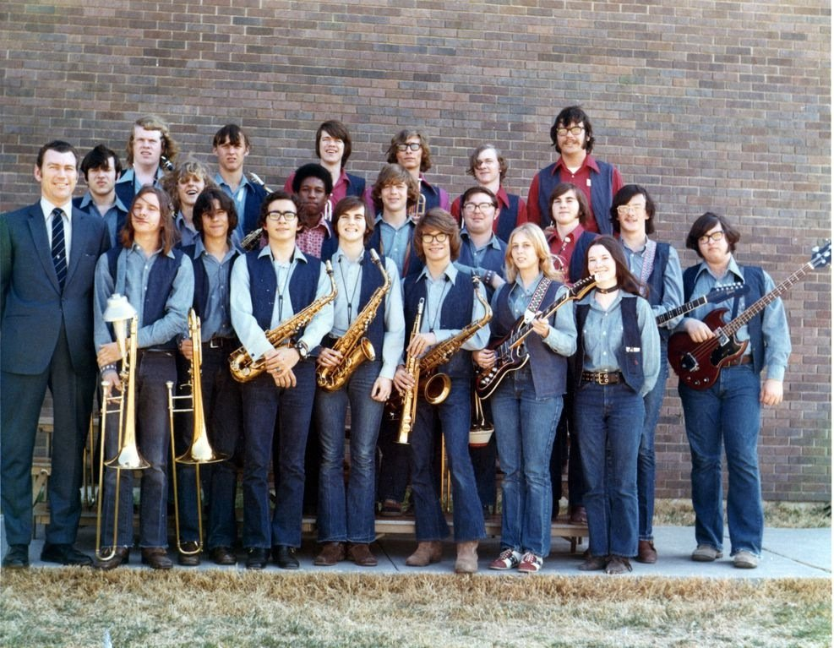
Formative years
My father was the band director at D.W. Carter high school (Dallas) from the day it opened until a year after I graduated. The expectations ran a little bit high with dad being band director in the Dallas area.
Long hair was the rule and not
The exception if you were in the
D.W. Carter jazz band. My dad
With the jazz band circa. 1972

Slide 9
The formative years
The vintage vehicles
In the background
Were more interesting
Than the band.
circa. 1974

Slide 10
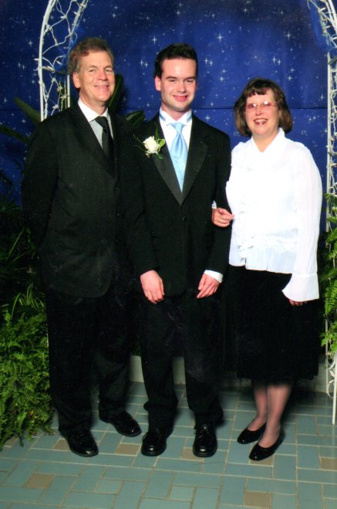
adulthood
After high school graduation, I took the long road to get my undergrad degree. Education was put on hold but I continued to play when given the opportunity. I was fortunate to find my wonderful wife Karen who is a queen. We have a (27 yr. old) son Scotty who is mildly autistic. We see things from a completely different perspective with Scotty.
My wonderful wife Karen and
Our son Scotty at one of his
School dances.

Slide 11
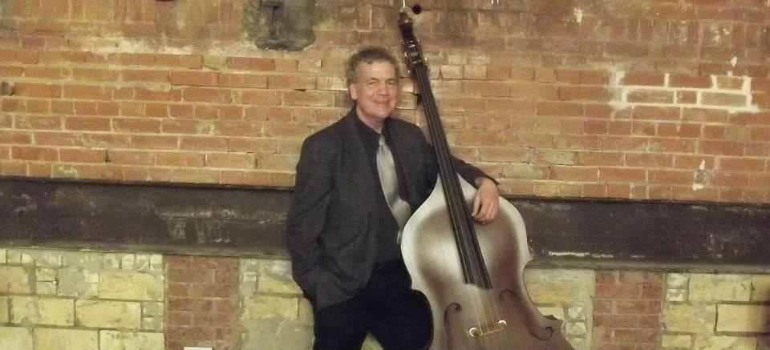
adulthood
I was hired as adjunct faculty at the junior college and university in Tyler to teach electric and string bass as well as jazz improvisation. At this time I was exploring options in obtaining a masters degree in music education.
Although I still play the trombone, it took
A temporary backseat to the upright bass.

Slide 12
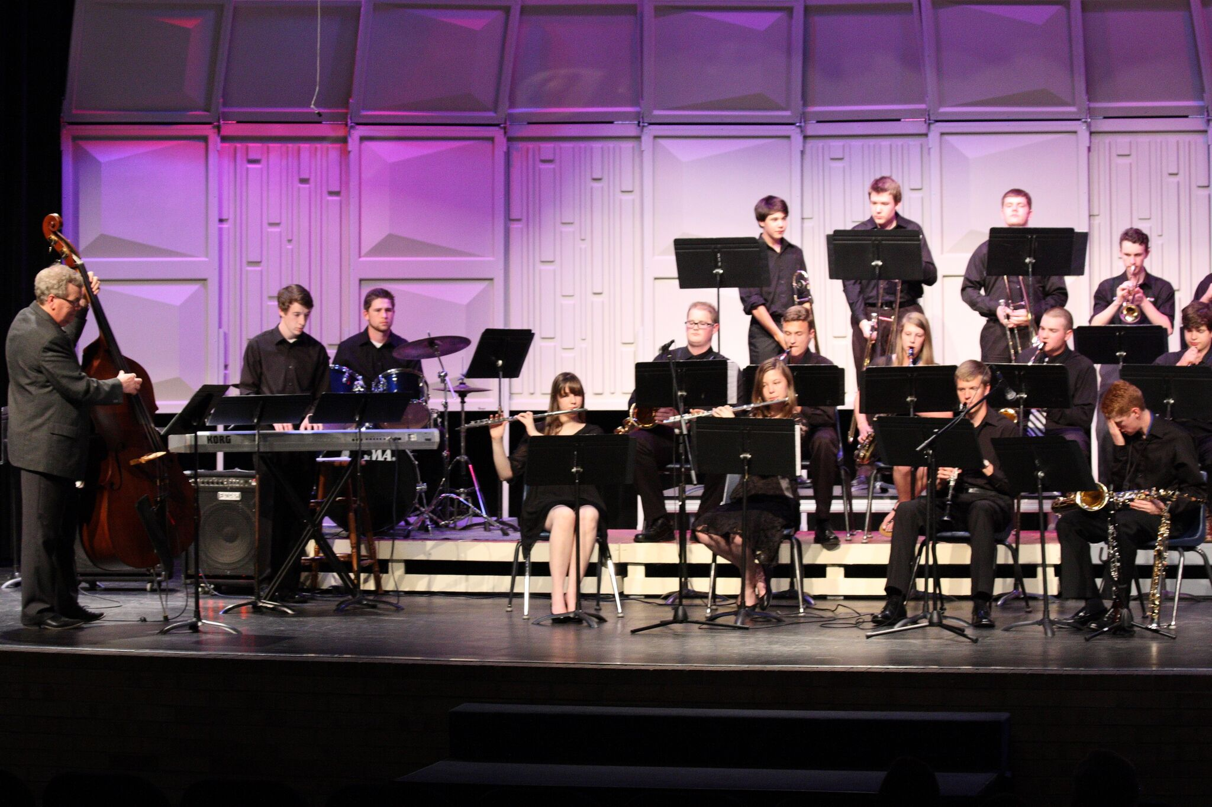
adulthood
As playing opportunities increased, I was offered my first band directing job at Grace Community School, which is a small private school in Tyler, Texas. I was director of bands for nine years and when there wasn’t a bass player, I enjoyed playing along with my kids.
Good times playing with the
Grace Community jazz band.

Slide 13
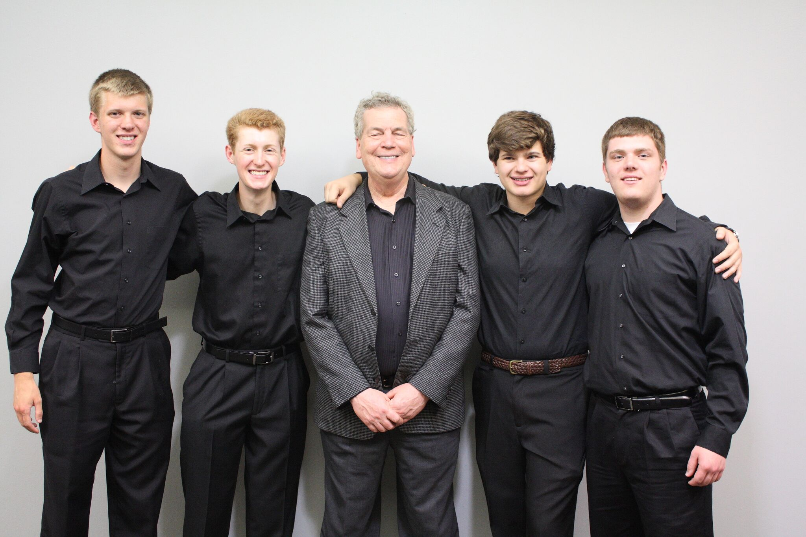
Adulthood
I didn’t feel completely equipped to be the best music educator for my students. I was fortunate and grateful to be accepted into this degree program and have learned so much from all of the professors at Tarleton.
Senior band students at
Grace Community School

Slide 14
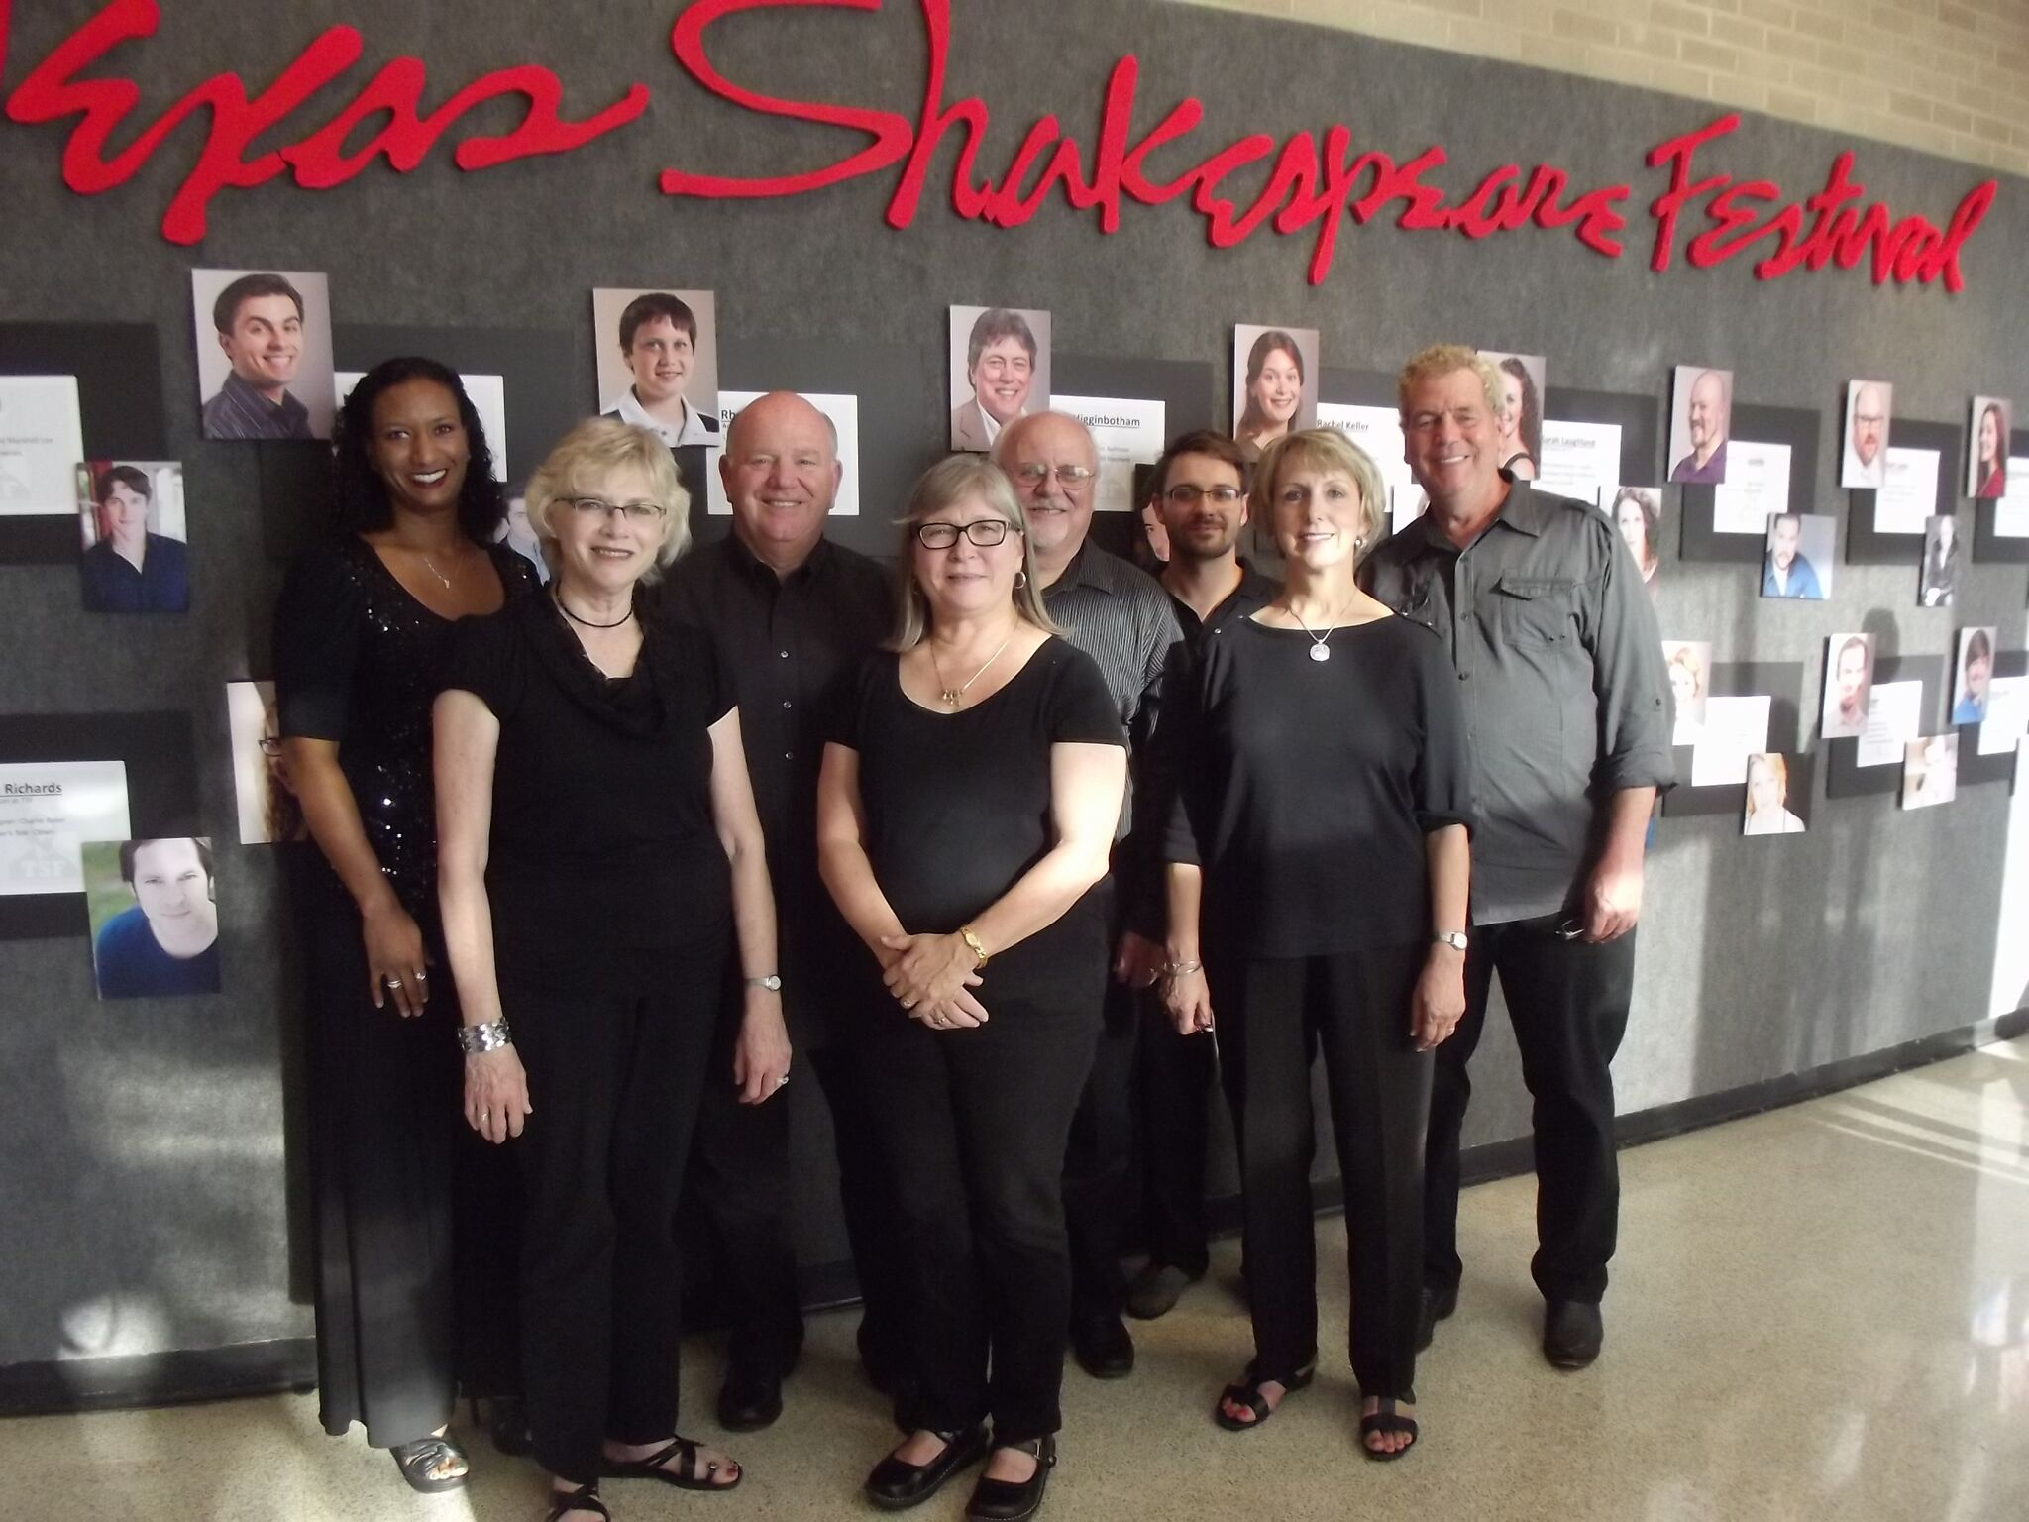
The good life
With very few bass players in the area who play both electric and string bass, and most importantly read music, I stay fairly busy over the weekends playing at a wide variety of venues with different bands. I have been part of the Texas Shakespeare Festival pit orchestra for the past fifteen years.
The pit orchestra for the
Texas Shakespeare Festival

Slide 15
The good life
I am now at the end of finishing this degree program and hope to graduate soon! This past spring I was hired to rebuild a band program at a small rural school and this fall will begin teaching orchestra and band at one of the Tyler Texas middle schools.
Although I never thought I would be
A band director like my dad while I
Was in high school, it has been so incredibly
Rewarding for me personally.

Slide 16
This is why I teach
My sixth grade band surprised
Me with their thoughts. This is
What makes teaching band
All worth while.

Slide 17
Thank you!
Thank you Tarleton State and the music faculty and staff for being part of the journey!

