Slide 1
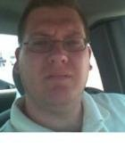
The Life and Times of Daniel White
My Life’s Journey Through Music

Slide 2
Beginning Years
Born January 1973.
Became interested in music at the age of 7 mainly due to movie soundtracks (John Williams) and church choir.
Took piano lessons at the age of 8.
Joined a small band program during the 4th grade and learned trumpet.
Switched to tuba in 6th grade.

Slide 3
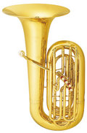
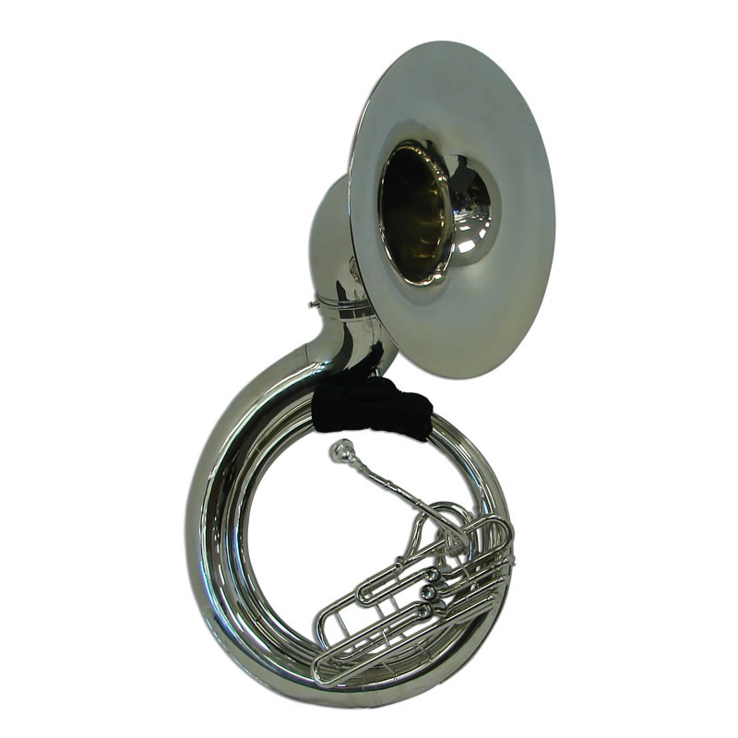
High School Years
Played sousaphone in the marching band.
Played concert tuba during concert season.
Learned to play the bass guitar my freshman year in high school.
Joined the jazz band for all 4 years.
Earned most valuable player in jazz band.
Joined the Texas National Guard Band during my senior year.
Left for boot camp two days after graduation.

Slide 4
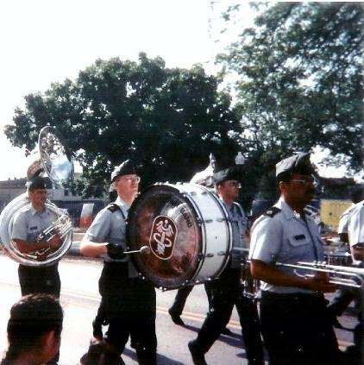
Military Years
After basic training, I liked performing music in the Texas National Guard Band so much I decided to go active duty 1 year later. I took the active duty audition and made it first try.
I was assigned to the U.S. Army School of Music in Little Creek Virginia. During this time we learned theory and ear training which equaled to the first 4 semesters of college theory and ear training. This school lasted for 6 months.
First duty station was Ft. Sam Houston in San Antonio Texas. Once in Texas, I became a member of the jazz band, concert band, rock ensemble and marching band.
Even though I was considered an electric bass player, I was still able to play tuba for concert band. I sometimes had to march bass drum or cymbals as part of the duty.

Slide 5
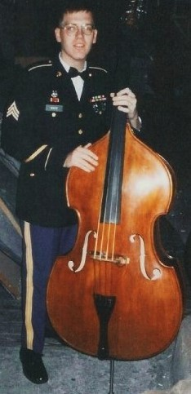
Military Life Continued
After 2 years in San Antonio, I was promoted to Sergeant and stationed in Seoul, Korea.
During this one year tour, I started learning the Double Bass, and met some great jazz performers in the Army as well as out in the civilian world. During this time I really started to practice my jazz chops and achieve playing expertise all over Korea. I was gigging nightly with some great cats from all over the world.

Slide 6
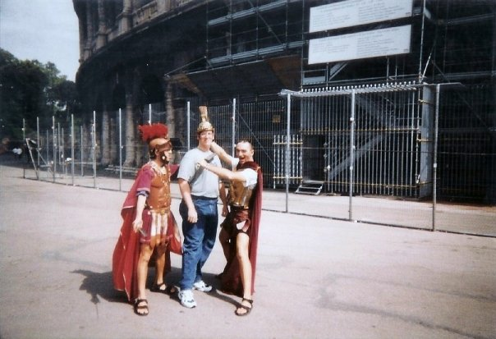
Military Life Continued
Returned to San Antonio for 3 years.
Relocated to Heidelberg, Germany in 1998.
Played with some more great jazz musicians and gigged around Germany.
Performed a 10 day tour of Italy playing in the great concert halls and seeing many sights including the Vatican and the Coliseum. But, if you pose with the actors, they expect a tip!!!
Played gigs in France, Belgium, Budapest, and Vienna.
Decided to leave the army and try my luck in the civilian sector.

Slide 7
Civilian Life and Back to School
Once I left the army, I tried working several security jobs, but I was filled with a sense of not being happy and working 20 hour days. I never saw my family during this time and my health was deteriorating.
I applied for my Veteran’s Assistance benefits and after 2 years was given a disability rating. Because of this rating I qualified for a special program called vocational rehab. It was at this time that I decided to go back to school full time and receive my Bachelor’s degree in music education.
I began my college years at the age of 28 going full time year round to the University of Texas at San Antonio.

Slide 8
College Years
I went to UTSA for 2 years but, after having some differing philosophies on music with the faculty, I transferred my last 2 years to St. Mary’s University in San Antonio, Texas.
I finished out my final hours and graduated with my degree in music on December 17th, 2005.

Slide 9
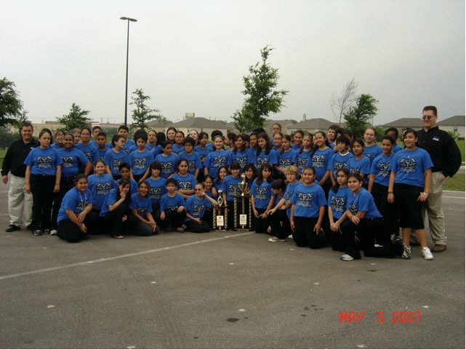
Teaching Years
I graduated in December of 2005 and by January 2006 I became a band director in Del Rio, Texas.
I began for a few years at the 6th grade beginning band. This grade level had its own campus and I was paired with another great director who took me under his wing and showed me many ideas in classroom management, lesson plans, and other ideas. This was a great time for me because I learned things that were never really covered in my college classes. After my mentor took another position with the district I became the head director for the beginning program.

Slide 10
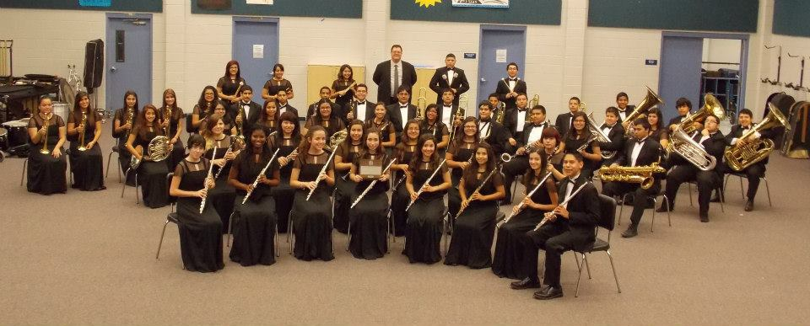
Teaching Years Continued
After 4 years at the beginner band program, I was transferred to Del Rio High School. I learned and am still learning many new things during this time.
I received my first UIL Sweepstakes while at the high school, and plan to continue growing as a band director.
This is my 11th year in Del Rio, and I am having a blast. I am currently the Concert Band Director (3rd Band), the 1st Jazz Band Director, and the 3rd Mariachi Director. Yep, being on the border of Mexico sure makes one learn new cultures and music!

Slide 11
House Bill 5 and Continuing Education
For many years I had thought about going back for my Master’s degree. But, due to the area of Texas I am currently living, that idea was never followed.
With the passing of HB5, new classes and music courses are being offered for high school, but only if the teacher has a Master’s degree.
In the fall of 2014 I heard about an online Master’s degree program though Tarleton State University. I was very intrigued by the idea of taking online classes, so I applied and was accepted into the Master’s degree program.

Slide 12
The Future
What does the future hold?
I hope that once I complete my degree, I will be able to teach some advanced music classes in the high school.
We currently have a community college in town with no music curriculum. I hope to be able to start a theory or technology class at the college level to give students in our town exposure to music classes other than band, choir, or strings.

