Slide 1
Getting to Know Me
By Chris Hassell

Slide 2
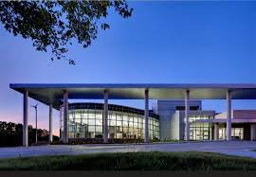
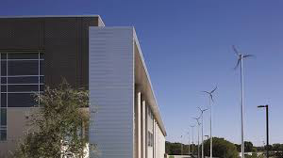
Where in the world am I?
I live in the DFW area and I am currently the Director of Bands at Lady Bird Johnson Middle School in Irving, TX. (Lady Bird is the largest “net-zero” green school in the US.) Most likely, I will be at a new campus in the fall, but I’ve enjoyed my time here. As you can see, that campus is state-of-the-art and beautiful.

Slide 3
How did I get here?
I’m a graduate of Amarillo High School in
Amarillo, TX. Amarillo in the middle of the
Texas Panhandle, and it feels a little more
Midwestern than Texan overall. It’s a wonderful
little town that’s pretty dull after 9 PM.
I’m a woodwind specialists that started on clarinet
In 5th grade. I quickly realized I needed money for
college, so I switched to bassson in high school to
help pay the bills.
I graduated from the University of North
Texas in 1995 and I’ve taught in the HEB,
Northwest, and Crowley, and Irving
school districts
Loved UNT, but I still don’t’ get how Green is Mean.

Slide 4
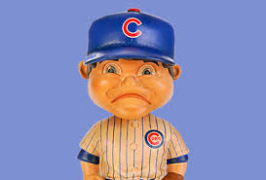
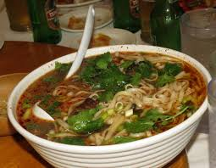
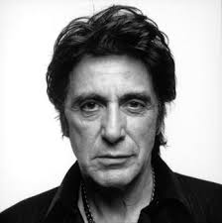
Could there possibly be more?
I’m a rabid Dallas Stars fan
I’m a long-suffering Rangers
and Cubs fan….
I love movies and…
I love to cook

Slide 5
Thanks to everyone for taking the time to browse my little presentation and remember one of my rules of life: You never win friends with salad.

